Slide 1

A Christ-Centered SEL & Leadership Formation Program
Bishop Diego High School • Grades 9-12

Slide 2
SENIOR • GRADE 12
Healthy Character II: Facing Reality
Focuses on the Character Structure of Integration—the ability to embrace both positive and negative realities about oneself and life. This module teaches students to move beyond an "all-or-nothing" mindset by integrating painful and redemptive experiences with hope and self-compassion.
CASEL FOCUS
Self-Management & Social Awareness
CST LENS
Hope & Redemption

Slide 3
Case Study: Lucy
Lucy is a dedicated Christian with a radical conversion story. She and her husband gave up everything and moved to another country to be missionaries and serve the poor. She believed that as long as she maintained intimacy with Jesus and allowed herself to believe only truth, her emotions would get in line. Her solution was to worship away or use Scriptures to quote away any negative emotions that came up inside her regarding the loss of her baby, the pain in her marriage, and the abuse and abandonment she experienced from her family of origin. After years of following the Lord, she had an emotional breakdown, wanted to separate from her husband, and planned to move on to something else to avoid the pain.
How could someone help Lucy?

Slide 4


The Character Structure of Integration
Integration: The ability to feel and deal with both positive and negative realities about self and life circumstances.
The ability to experience love and acceptance while experiencing and knowing ones failure, loss, or imperfection

Slide 5

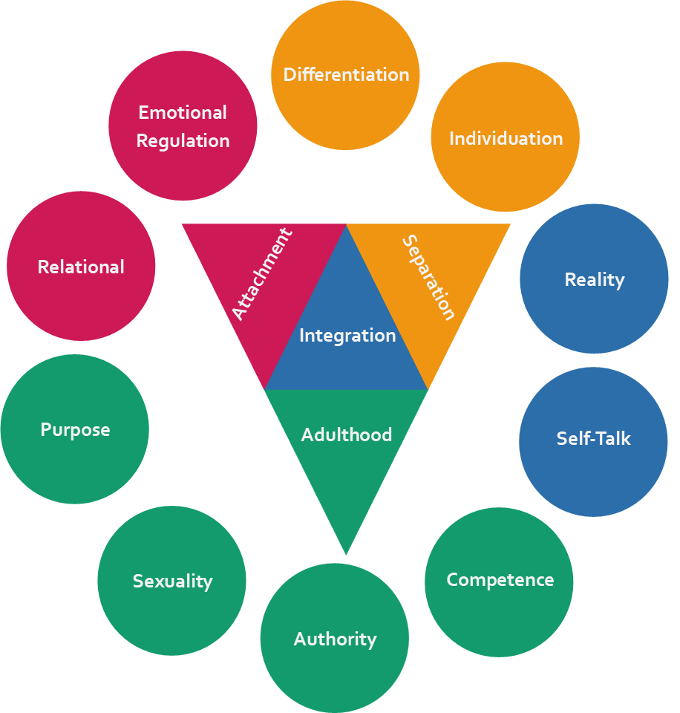
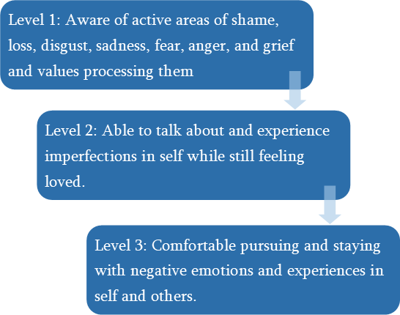
Character Structure of Integration

Slide 6

Video Activity
Watch: Clip from Reign on Me
Write down three observations from the video that describe Charlie’s character structure of Integration deficiency and how he grows as a result of what happens in the clip.

Slide 7
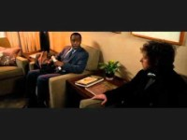

Slide 8
Video Activity
Share your observations or lyrics from the video that describe Charlie’s character structure of Integration deficiency and how he grew as a result of what happened in the clip in a group of three or four.

Slide 9
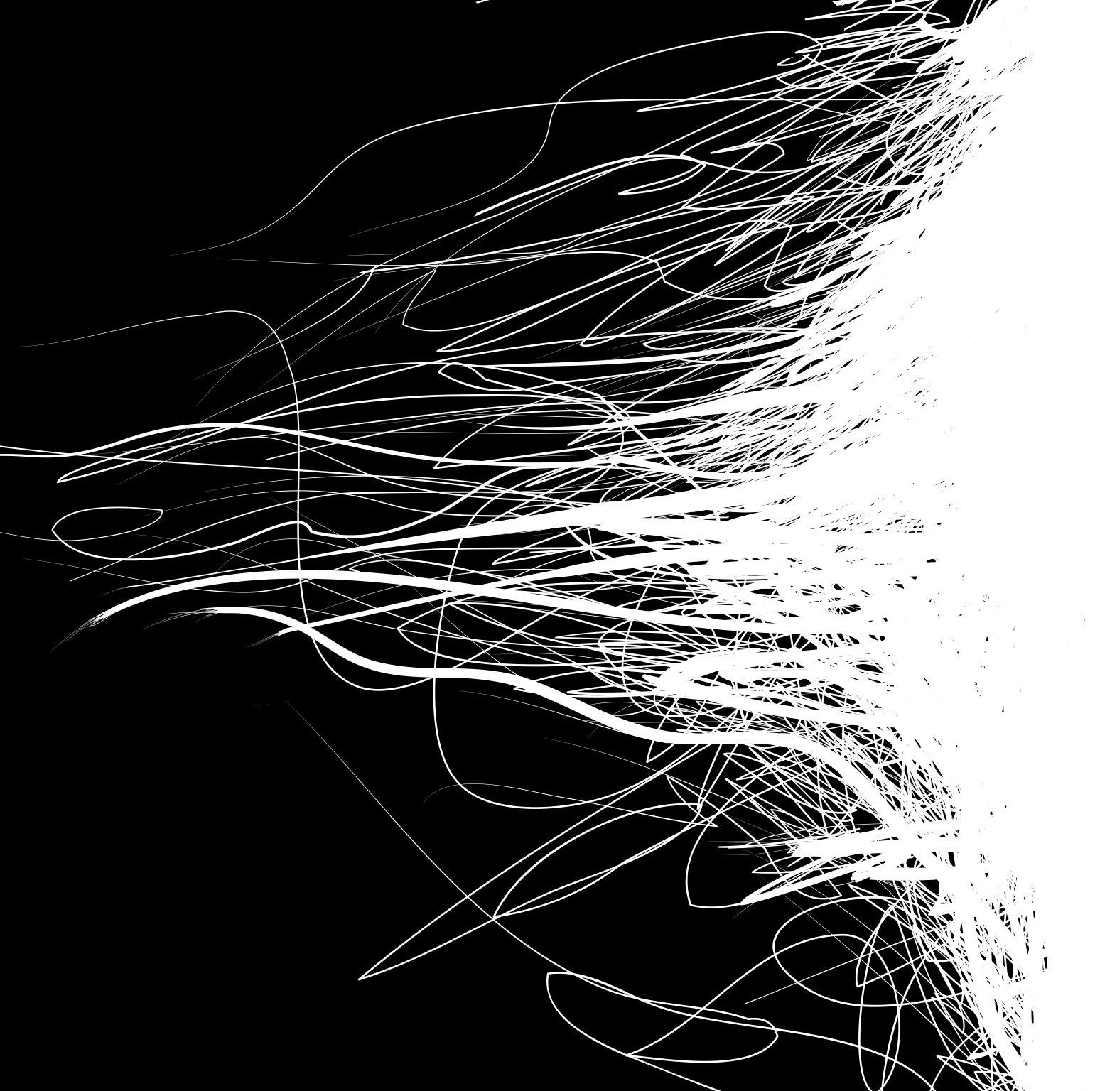
Dealing with Good and Bad
We are not “all good” or “all bad,” we are “in progress”
Ideal Self vs. the Real Self and the war between them (self talk)
My own splitting of good and bad: My “mother’s son” and “father’s son” split

Slide 10
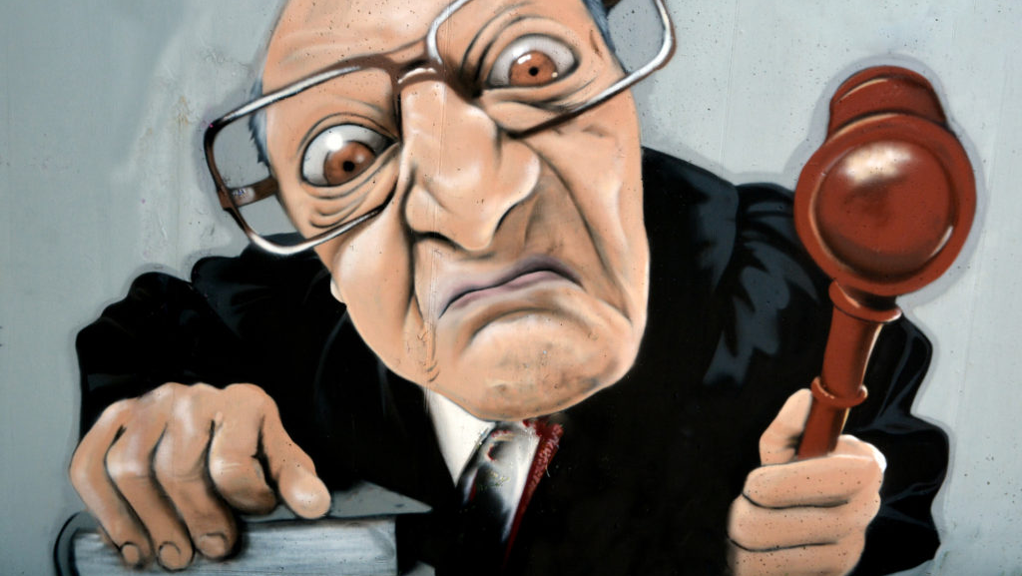
The Internal Critical Judge
The internal demand for perfection
We often make small failures, total failures
We are often our harshest critics

Slide 11

How to develop a soft, loving internal voice
Although we strive for excellence, we will all fail sometimes
We develop a soft, loving internal voice when we experience love and acceptance from others when we both fail and when we succeed.
Getting affirmations based on character qualities rather than those qualities that we were born with such as good looks and IQ helps as well

Slide 12

-Daniel Siegel

Slide 13
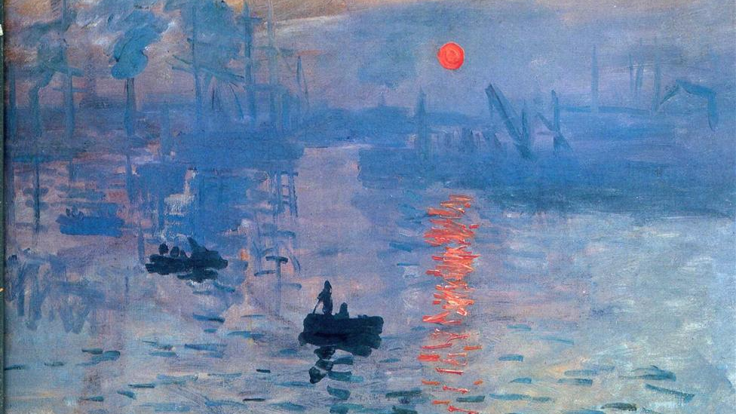
True acceptance
We can’t truly accept a person until we see their good, bad, and ugly sides.
A false view of acceptance (“If you don’t agree with me than you don’t accept me”)
The true view of acceptance (You can hold a different moral or social view than another person and still accept and want someone in your life)

Slide 14
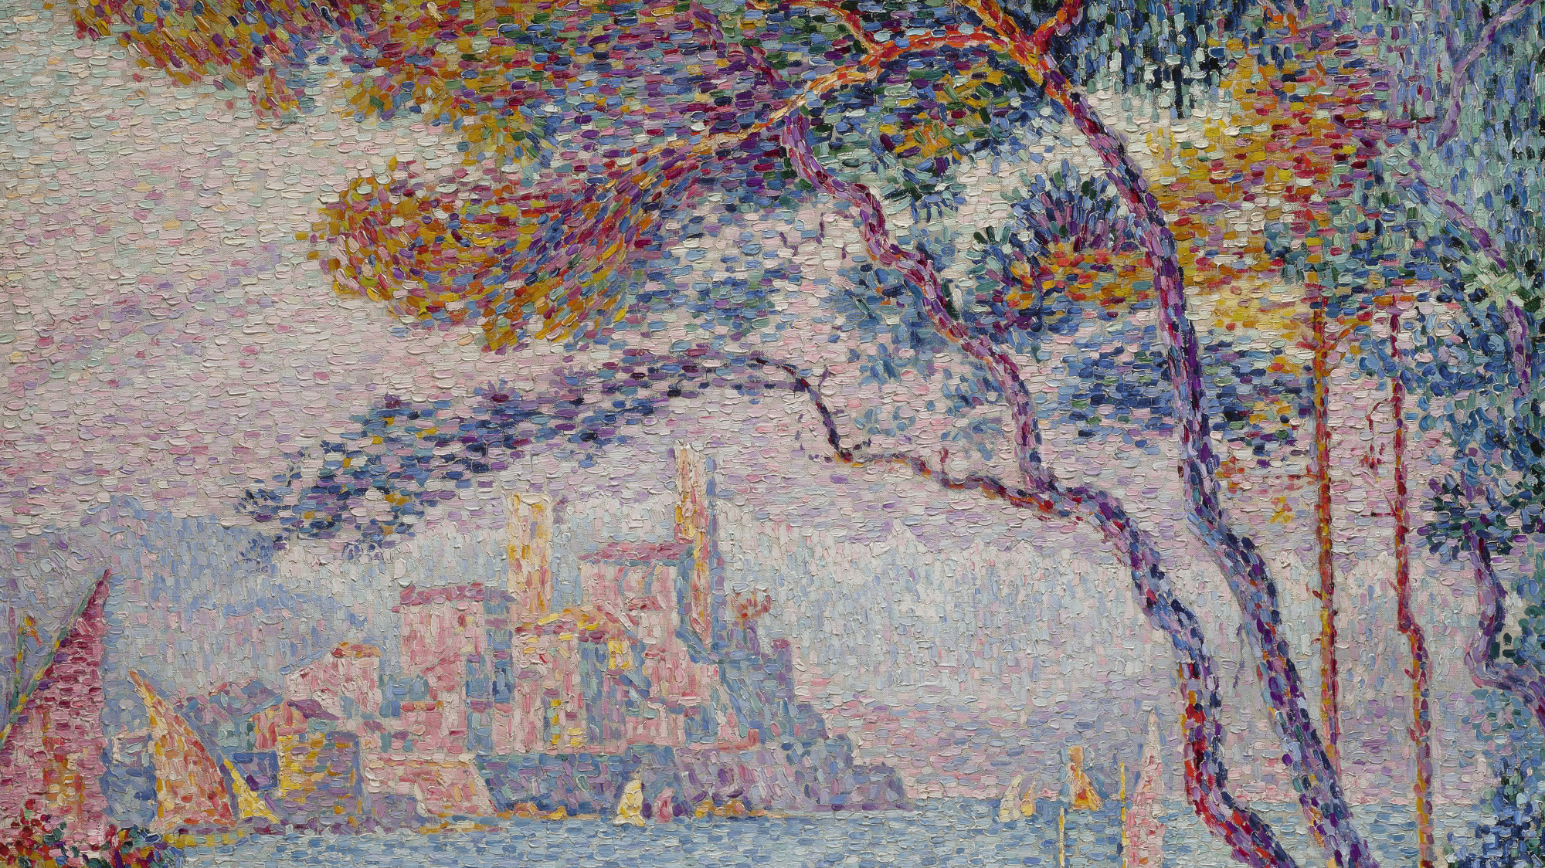
Stages of Relationship
1.) Honeymoon (experiences the good)
2.) Disillusionment (experiences the bad)
3.) Enjoyment (accepts the good and the bad)

Slide 15
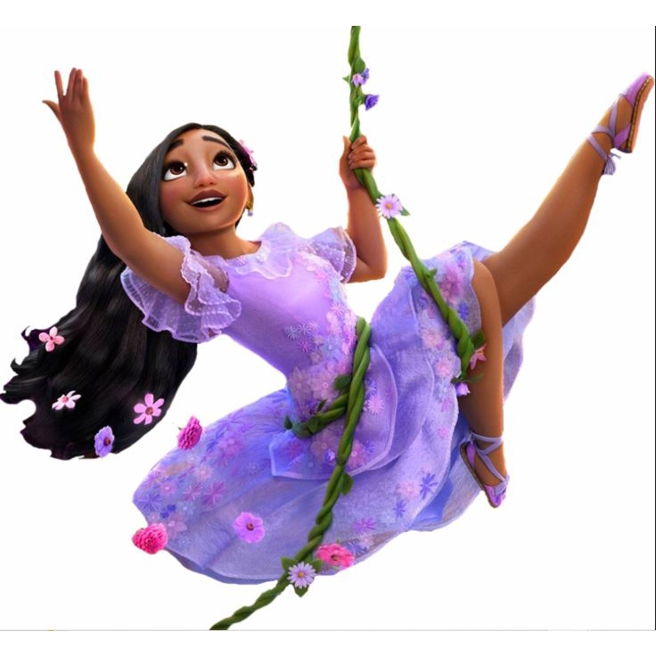
Video Activity
Watch: A clip from Enchanto
Write down three observations from the video that describe Isabela’s character structure of Integration deficiency.
Isabela fights hard to project a “perfect” image of herself all the time.

Slide 16
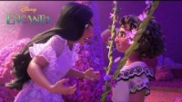

Slide 17
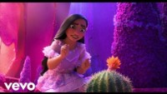

Slide 18
Video Activity
Share your observations or lyrics from the video that describe Isabela’s character structure of Integration deficiency in a group of three or four.
What other movies character’s can you think of that are deficient in the character structure of integration?

Slide 19
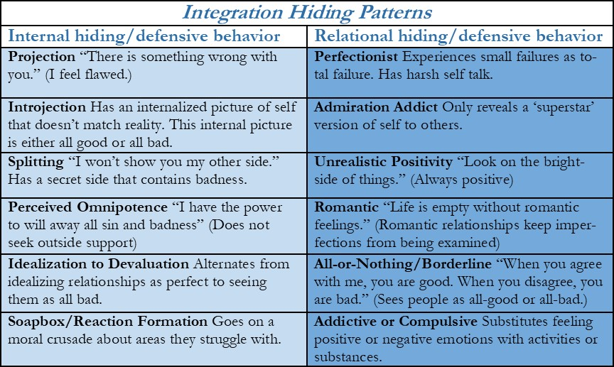

Slide 20

What is available for Bishop Students?
As a personal counselor, I am available to meet with you to help you process difficult to process life circumstances.
Feel free to come to my office, or to email me if you desire to meet with me one on one.
Mr. Eggman: AEggman@bishopdiego.org.
•
•
•
•

Slide 21
Questions?

